Slide 1
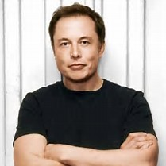
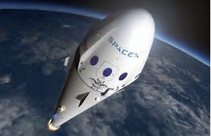
SPACEX

Slide 2
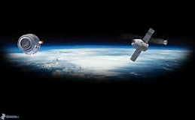
Space Exploration Technologies (SPACEX) is an american aerospace manufacturer and space transport services company
It was founded in 2002 by entrepreneur Elon Musk with the goal of reducing space transportation costs and enabling the colonization of Mars.
The company has grown rapidly since it was founded, growing from 160 employees in November 2005 to nearly 6,000 employees in April 2017.

Slide 3
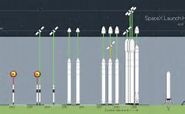
SpaceX started with the smallest useful orbital rocket, instead of building a more complex and riskier launch vehicle, which could have failed and bankrupted the company.
A major goal of SpaceX has been to develop a rapidly reusable launch system.
Landmark achievements of SpaceX include:
The first privately funded liquid-fueled rocket to reach orbit (Falcon 1 Flight 4 — September 28, 2008).
The first privately funded company to successfully launch, orbit, and recover a spacecraft (Falcon 9 Flight 2 — December 9, 2010)
The first private company to send a spacecraft to the International Space Station (Falcon 9 Flight 3 — May 25, 2012)
The first reflight of a commercial cargo spacecraft. (Falcon 9 Flight 35 — June 3, 2017)

Slide 4
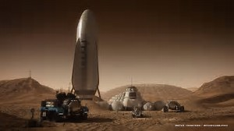
At year-end 2012, SpaceX had over 40 launches on its manifest representing about $4 billion in contract revenue. The contracts included both commercial and governmental (NASA/DOD) customers.
In late 2013, space industry media began to comment on the phenomenon that SpaceX prices are undercutting the major competitors in the commercial comsat launch market—the Ariane 5 and Proton-M—at which time SpaceX had at least 10 further orbit flights on its books.
Musk's long term vision for the company is the development of technology and resources suitable for human colonization on Mars. He has expressed his interest in someday traveling to the planet, stating "I'd like to die on Mars, just not on impact.

